Slide 1

Exploratory Data Analysis
G2M Insights
Akhil Abraham
LISUM21
21-05-2023

Slide 2

Agenda
Executive Summary
Problem Statement
Approach
EDA
EDA Summary
Recommendations

Slide 3
Executive Summary
XYZ is a private firm in US. Due to remarkable growth in the Cab Industry in last few years and multiple key players in the market, it is planning for an investment in Cab industry and as per their Go-to-Market(G2M) strategy they want to understand the market before taking final decision.
Hypothesis:
Do male and female customers have significantly different average trip costs?
Does the gender of the customer affect the choice of payment mode for the cab service?
Are there variations in the average profit earned during holidays compared to regular days?
Is there a significant difference in the average profit earned by different payment modes?
Is there a significant difference in the average profit earned by different gender groups?¶

Slide 4
Problem Statement
The objective of this analysis is to provide actionable insights and recommendations to XYZ, a private firm planning to invest in the Cab Industry. By examining multiple data sets and conducting exploratory data analysis (EDA), we aim to identify the right cab company for investment based on various factors such as customer segments, company performance, and market trends.

Slide 5
Approach
Data used from GitHub.
Date format was changed from numeric to year-month-date.
Converted String numerical to integer numerical.
Usage of appropriate decimal points.
Created a new column for profit.
Data was cleaned, manipulated, and merged.

Slide 6
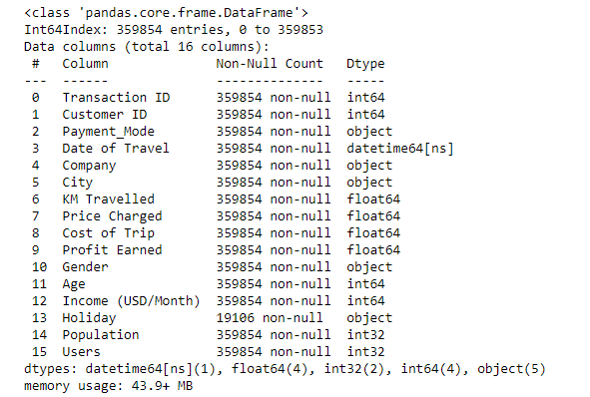
Exploratory Data Analysis

Slide 7
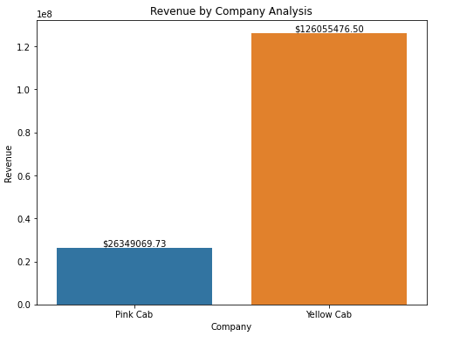
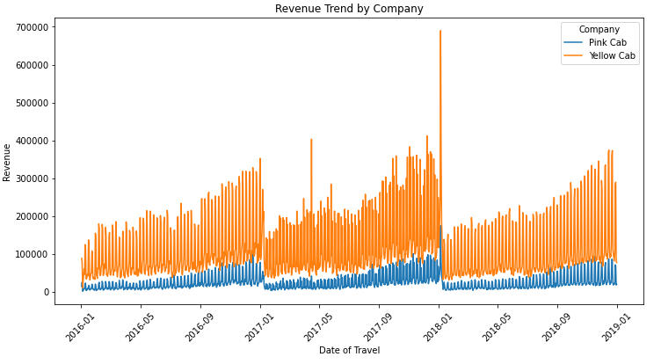
Revenue Analysis

Slide 8
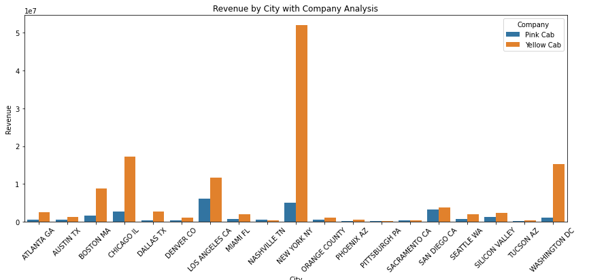

Slide 9
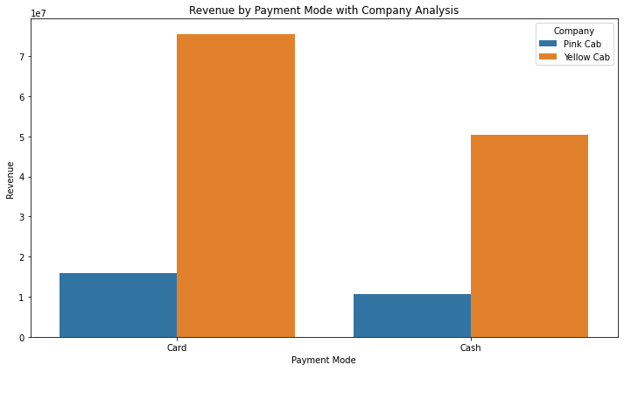
Revenue by company: price charged by the Yellow company is higher than Pink company
Revenue by trend: Seasonality can be observed and during those peaks Yellow Cabs is performing better.
Revenue by city: New York riders are more likely to buy cabs.
Revenue by Company: Overall Yellow Cabs are performing better.

Slide 10
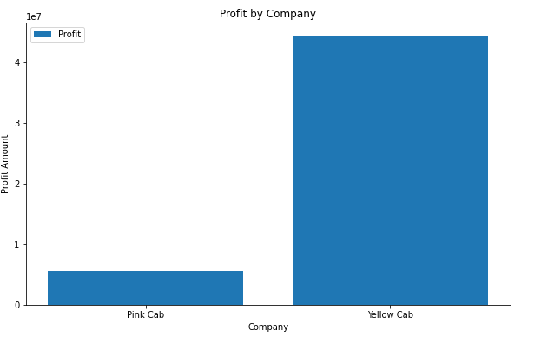
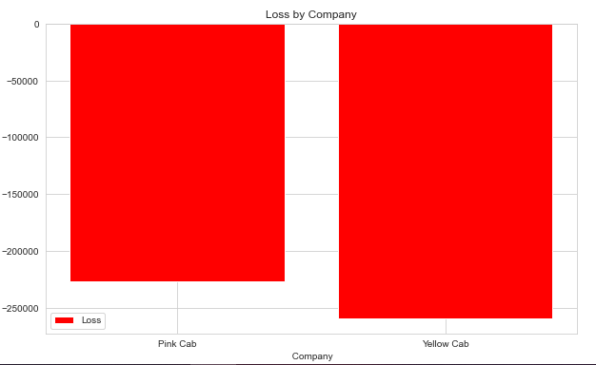
Profit Analysis

Slide 11
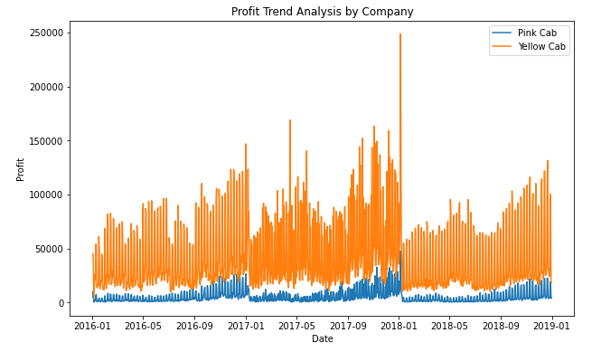
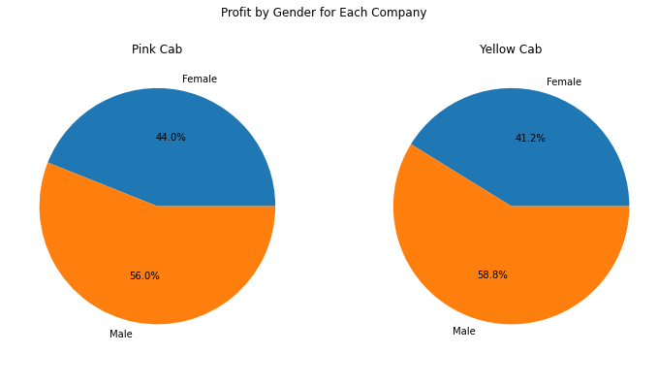

Slide 12
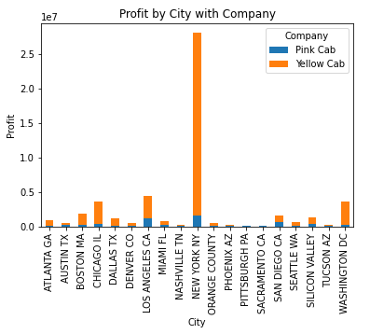
Profit and Loss: Profit to loss ratio for Yellow Cabs (171.063154) is higher than Pink Cabs(24.401612), thus Yellow Cab will give more profit throughout the year.
Profit trend: Seasonality is observed and more Profit obtained during the holidays.
Gender wise: Male riders are more than female riders in both companies.
City wise: New York, Washington and LA has the most profit. More cabs are likely to be ordered here.

Slide 13
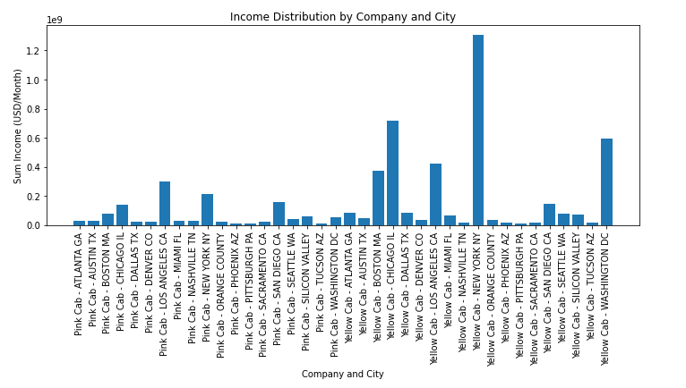
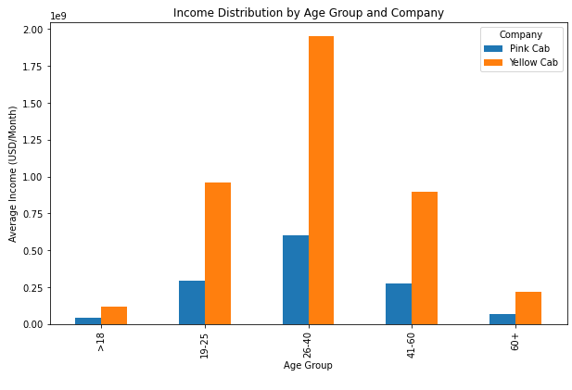
Income Analysis
New York, Washington and Chicago has user with high average income. We might get good customers booking cabs from these cities.
Customers within age range 26-40 are working class and are more likely to book cabs.

Slide 14
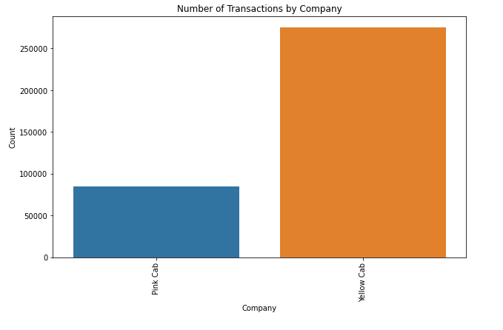
No. of transactions
This graph shows how the customer transaction is distributed. Most of the booked customer transaction are at Yellow Cabs and thus we can infer that the customers trust Yellow Cabs more than Pink Cabs.

Slide 15
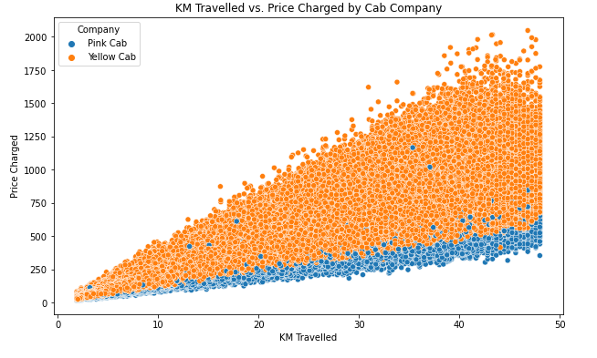
KM traveled vs price charged
This plot shows between distance traveled and the prices charged for each transactions. We see a pattern that with more the distance the higher the prices. The Pink Cab charged price per km must be lower than Yellow Cab charged price per km. We also see some outliers for Pink Cab which could be due to XL or premium cabs. Yellow Cabs in this situation is performing better than Pink Cabs.

Slide 16
EDA Summary
After a through analysis of Revenue, Profit and Income, It is evident that people cab riders prefer Yellow Cabs over Pink Cabs and Profit earned is more. With more the riders in each city more profit we earn. Profit margin is high in Yellow Cabs.
Seasonality can be observed during certain time period the cost is higher and customers are still choosing Yellow Cabs over Pink Cabs.
Overall, We observe Yellow Cabs to perform better at all aspects.

Slide 17
Hypothesis Tests
Hypothesis 1: Do male and female customers have significantly different average trip costs?
Results: we can infer that male and female customers have significantly different average trip costs.
Hypothesis 2: Does the gender of the customer affect the choice of payment mode for the cab service?
Results: There is no significant association between the gender of the customer and the choice of payment mode for the cab service.
Hypothesis 3: Are there variations in the average profit earned during holidays compared to regular days?
Results: we can infer that there are significant variations in the average profit earned during holidays compared to regular days.
Hypothesis 4: Is there a significant difference in the average profit earned by different payment modes?
Results: there is no significant difference in the average profit earned by different payment modes.
Hypothesis 5: Is there a significant difference in average profit earned by different gender groups?
Results: we can infer that there is a significant difference in the average profit earned by different gender groups.

Slide 18
Recommendation
With all analysis and results from hypothesis at hand, It is very clear that Yellow Cabs are worth investing and will provide good profit from it.
From Seasonality, we found that price charges during holidays are higher which will improve our profits.
We could attract more people from range 26-40 as they are working class and most of the transactions are from this age group.
WE RECOMMEND INVESTING IN YELLOW CABS

Slide 19
Thank You

